Slide 1
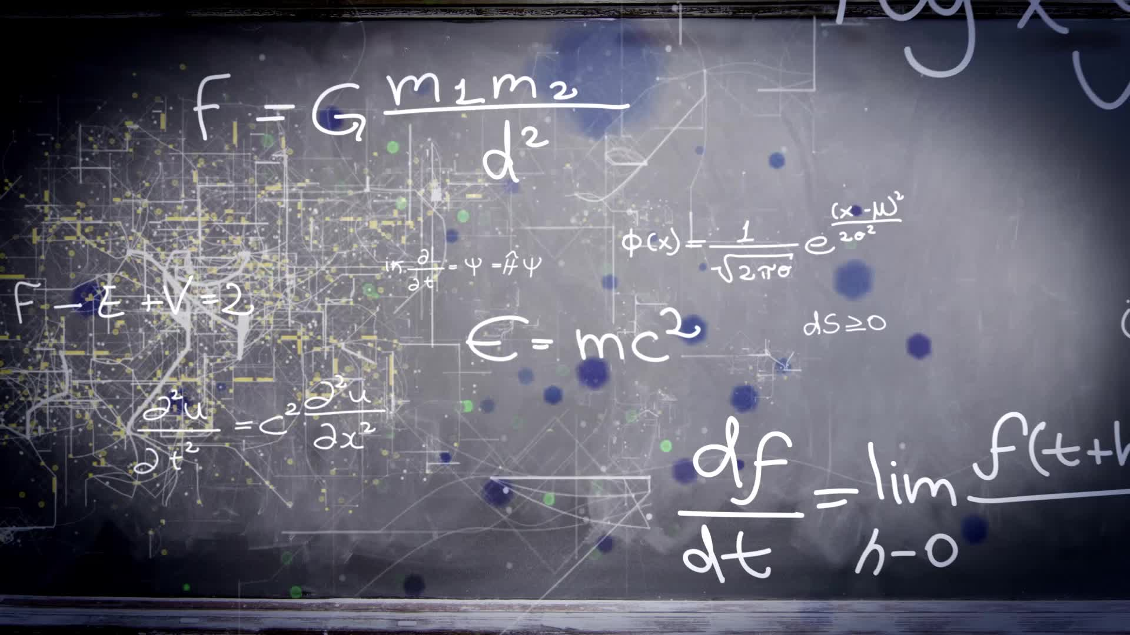
Game Physics Basics

Slide 2

Fluid Mechanics

Slide 3
What is a fluid?
Substance with no strength
Deform when forces are applied
Includes water and gases
Solid :
Deforms a fixed amount or breaks completely when a stress is applied on it
Liquid :
Deforms continuously as long as any
shear stress is applied.

Slide 4
Type of Stresses?
Stress = Force /Area
Shear stress/Tangential stress:
The force acting parallel to the surface per unit area of the surface.
Normal stress:
A force acting perpendicular to the surface per unit area of the surface.

Slide 5
How Do We Study Fluid Mechanics?
Basic laws of physics:
Conservation of mass
Conservation of momentum – Newton’s second law of motion
Conservation of energy: First law of thermodynamics
Second law of thermodynamics
+ Equation of state
Fluid properties e.g., density as a function of pressure and temperature.
+ Constitutive laws
Relationship between the stresses and the deformation of the material.

Slide 6
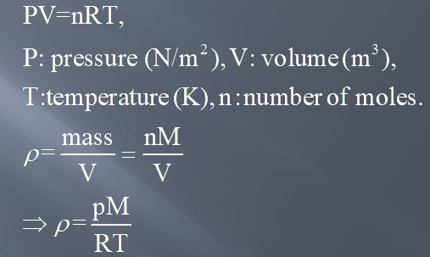
How Do We Study Fluid Mechanics?
Example: Density of an ideal gas
Ideal gas equation of state

Slide 7
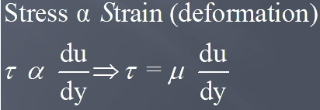

Newton’s law of viscosity:

Slide 8
Viscosity
It is define as the resistance of a fluid which is being deformed by the application of shear stress.
In everyday terms viscosity is “thickness”. Thus, water is “thin” having a lower viscosity, while honey is “think” having a higher viscosity.
Common fluids, e.g., water, air, mercury obey Newton's law of viscosity and are known as Newtonian fluid.
Other classes of fluids, e.g., paints, polymer solution, blood do not obey the typical linear relationship of stress and strain. They are known as non-Newtonian fluids.
Unit of viscosity: Ns/m² (Pa.s)

Slide 9
Games with Fluids
Below, games where fluids play a bigger part than visually appealing surfaces are listed.
In Flower (2009), you play as wind, and you carry petals. The wind you play as, however, is a single rigid body unit. It does not behave like a fluid but only animates as you control it and triggers other animations such as the grass’ movement.
One of the base mechanics in The Legend of Zelda: The Wind Waker (2002) is that you can control which way the wind blows and draw use of that with different equipment. This wind does not behave much like a fluid either. It is generalized to the same constant everywhere.

Slide 10
Minecraft (2011) is grid-based and has liquid source blocks that pour liquid but stay where you placed them. The cells they fill with water may have a stream-effect which carries some objects in its direction.
In Subnautica (2018), you are stuck on an ocean planet and forced to explore its waters to survive. It gets darker the deeper you go, and the pressure increases (possibly damaging your submarine). However, there are no real different water masses or currents. The sea is a constant.
Splatoon (2015) uses particle-based fluid simulation for their guns. The fluid they shoot hits rigid objects, color them, and disappear.

Slide 11
Thank You

